Slide 1
PERSONALIZED AI MENTOR FOR VARIOUS BUSINESS
GUIDE:
Dr.R.JOSPHINELEELA M.E,Ph.D
TEAM MEMBERS:
PRIYADHARSHAN S(211420104205)
SURAJ R(211420104275)
SURAJ Y(211420104339)

Slide 2
BASE PAPER
Building Trustworthy AI Solutions A Case for Practical Solutions for Small Business – Aug 2023

Slide 3
ABSTRACT
The Proposed AI System envisions the creation of AI assistants tailored to various business domains. These AI assistants would serve as specialized virtual advisors, each dedicated to a specific area such as Sales , Transport and HRM.
The AI assistants would leverage advanced NLP, Machine Learning and AI model frameworks to provide intelligent and context-aware responses.
Clients would benefit from personalized consultations, actionable insights and problem-solving recommendations.
AI consulting offers numerous benefits including increased sales, reduced costs, enhanced customer satisfaction, increased profit, decreased loss, and improved decision-making.
AI-powered systems enhance business consultants' efficiency by providing quick, accurate answers to client demands.

Slide 4
TECH STACK
FULL STACK TOOLS USED
ML TOOLS USED
ANGULAR
EXPRESSJS
DJANGO
AWS
POSTGRESQL
NLTK
LANGCHAIN
LLAMA 2
HUGGING FACE

Slide 5
EXISTING SYSTEM
Every company will have its own management system and won't integrate with any other companies. Big bots aren't appropriate for little businesses; they are exclusively for huge ones.
It could be difficult for clients and staff to comprehend and believe the AI-driven advice. Lack of knowledge about the inner workings of the system may cause resistance and doubt.
Concerns regarding data security and privacy are brought up by the usage of large datasets. Strong security measures are necessary when processing and storing sensitive company data in order to avoid data breaches and unauthorized access.

Slide 6
DISADVANTAGES
Respecting current and developing laws concerning AI applications across a range of industries is essential. Legal problems and reputational harm could result from breaking regulatory rules.
There may be difficulties in integrating the AI system with the software and business procedures now in use. A smooth transition can be impeded by compatibility problems, downtime during the integration process, and employee opposition.
The process of implementing advanced AI systems necessitates large upfront expenditures for the acquisition of technologies, model training, and infrastructure integration.

Slide 7
PROPOSED SYSTEM
The proposed AI system envisions the creation of AI assistants tailored to various business domains.
These AI assistants would serve as specialized virtual advisors, each dedicated to a specific area such as Sales , Transport and HRM.
The AI assistants would leverage advanced NLP, machine learning, and AI model frameworks to provide intelligent and context-aware responses.
Clients would benefit from personalized consultations, actionable insights, and problem-solving recommendations.

Slide 8
ADVANTAGES
AI can provide solutions in seconds, reducing turnaround times from hours to days.
AI consulting offers numerous benefits including increased sales, reduced costs, enhanced customer satisfaction, increased profit, decreased loss, and improved decision-making.
This allows them to focus on higher-level tasks and improves accuracy through machine learning algorithms, enhancing the quality of service provided to clients.
AI-driven systems offer clients faster response times and customized solutions by processing vast datasets.

Slide 9
COMPARISON TABLE
EXISTING SYSTEM
PROPOSED SYSTEM
Every company will have its own management system and won't integrate with any other companies.
Big bots aren't appropriate for little businesses; they are exclusively for huge ones.
It could be difficult for clients and staff to comprehend and believe the AI-driven advice
The proposed AI system envisions the creation of AI assistants tailored to various business domains.
These AI assistants would serve as specialized virtual advisors, each dedicated to a specific area such as Sales , Transport and HRM.
The AI assistants would leverage advanced NLP, machine learning, and AI model.

Slide 10
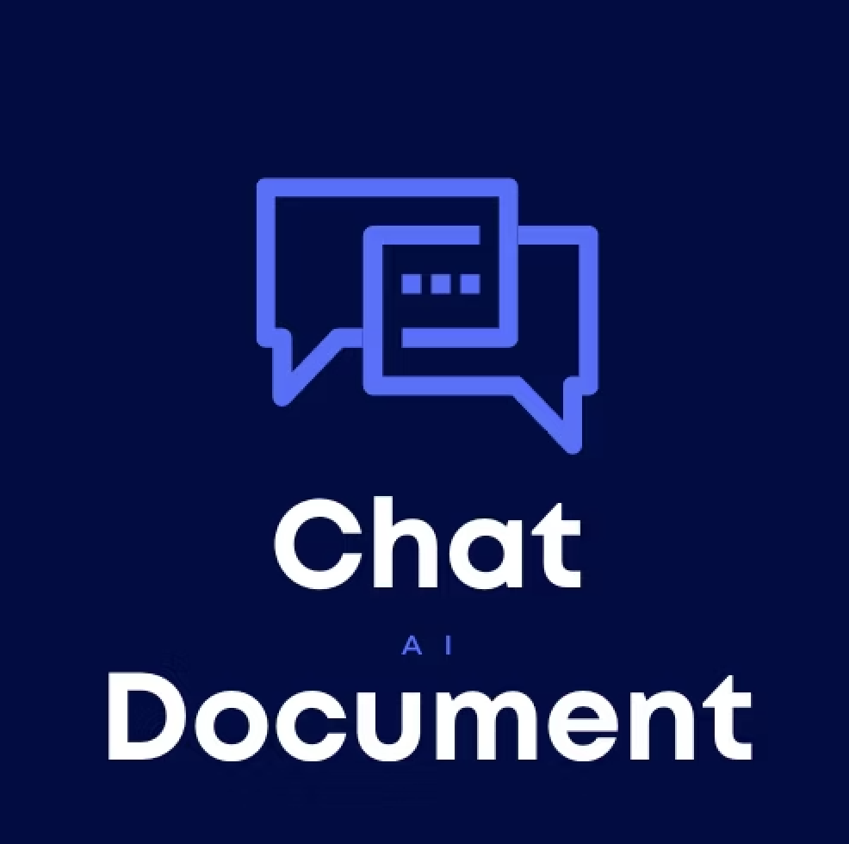

MODULES
CHAT WITH DATABASE
CHAT WITH DOCUMENTS
SUMMARIZER
ERP MANAGEMENT

Slide 11
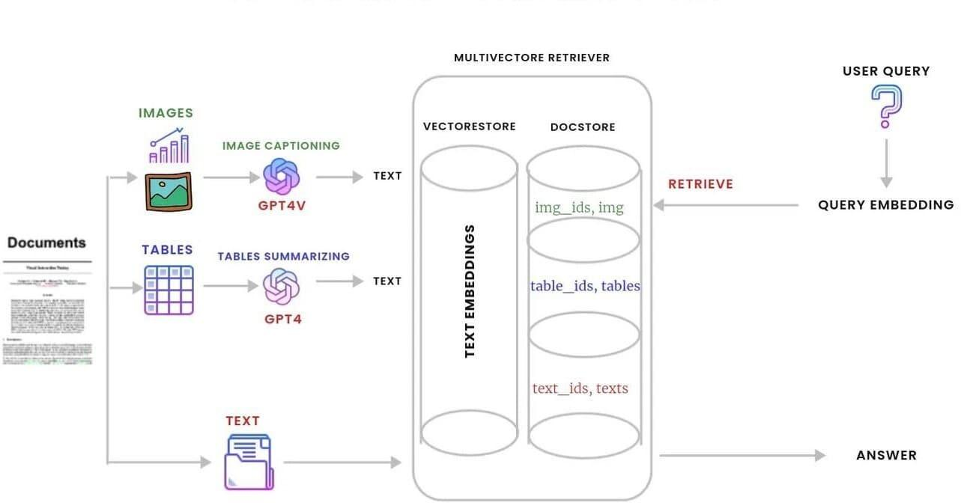
ARCHITECTURE DIAGRAM

Slide 12
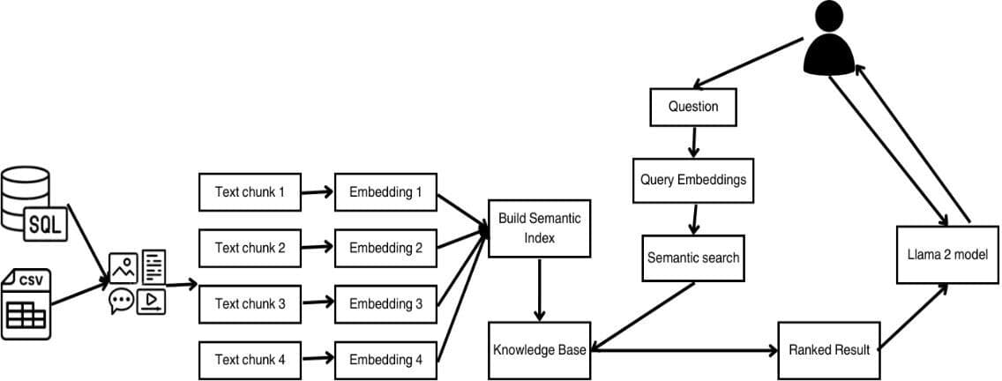
CHAT WITH DATABASE

Slide 13
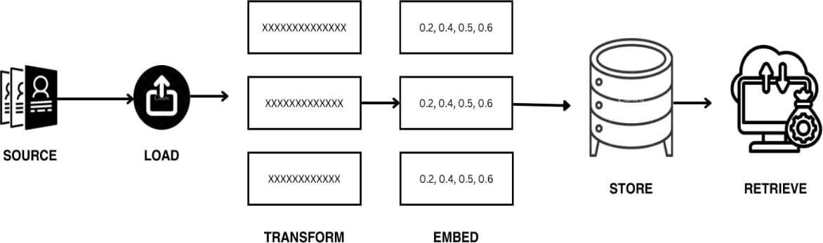
CHAT WITH DOCUMENTS

Slide 14
SUMMARIZER
● These summaries provide a condensed representation of the original text, allowing users to grasp key points and essential details quickly. This functionality extends to user queries as well.
● When users pose questions, the AI model not only retrieves pertinent information but also presents it in a summarized format, complete with interactive visualizations for better comprehension

Slide 15
ERP INTEGRATION
Our innovative approach seamlessly integrates with existing ERP software systems, acting as a supercharger for data management and decision-making. ERP systems, the backbone of many businesses, streamline core functionalities like resource planning, customer relationship management, and inventory control.
They provide a centralized platform, unifying diverse business processes under one roof. This robust framework becomes even more powerful when infused with the transformative capabilities of text processing techniques like embeddings, semantic indexing, and summarization.

Slide 16
LITERATURE SURVEY
S.NO | YEAR | NATION | PAPER TITLE | METHODOLOGY | LIMITATION
1 | 2019 | European Commission | General data protection regulation | The Regulation comes establishes guidelines for both the free flow of personal data and the protection of natural people with relation to its processing Natural persons. | The latter are merely one interpretation of the law and are not legally enforceable. The European Court of Justice is the only body with authority.

Slide 17
S.NO | YEAR | NATION | PAPER TITLE | METHODOLOGY | LIMITATION
2 | 2021 | UNITED NATIONS | A framework for ethical AI for the united nation | In addition to offering a framework for reducing those risks, the purpose of this article is to give an overview of the ethical issues surrounding artificial intelligence (AI) and to offer a workable solution moral principles. | The latter are merely one interpretation of the law and are not legally enforceable. The European Court of Justice is the only body with authority.

Slide 18
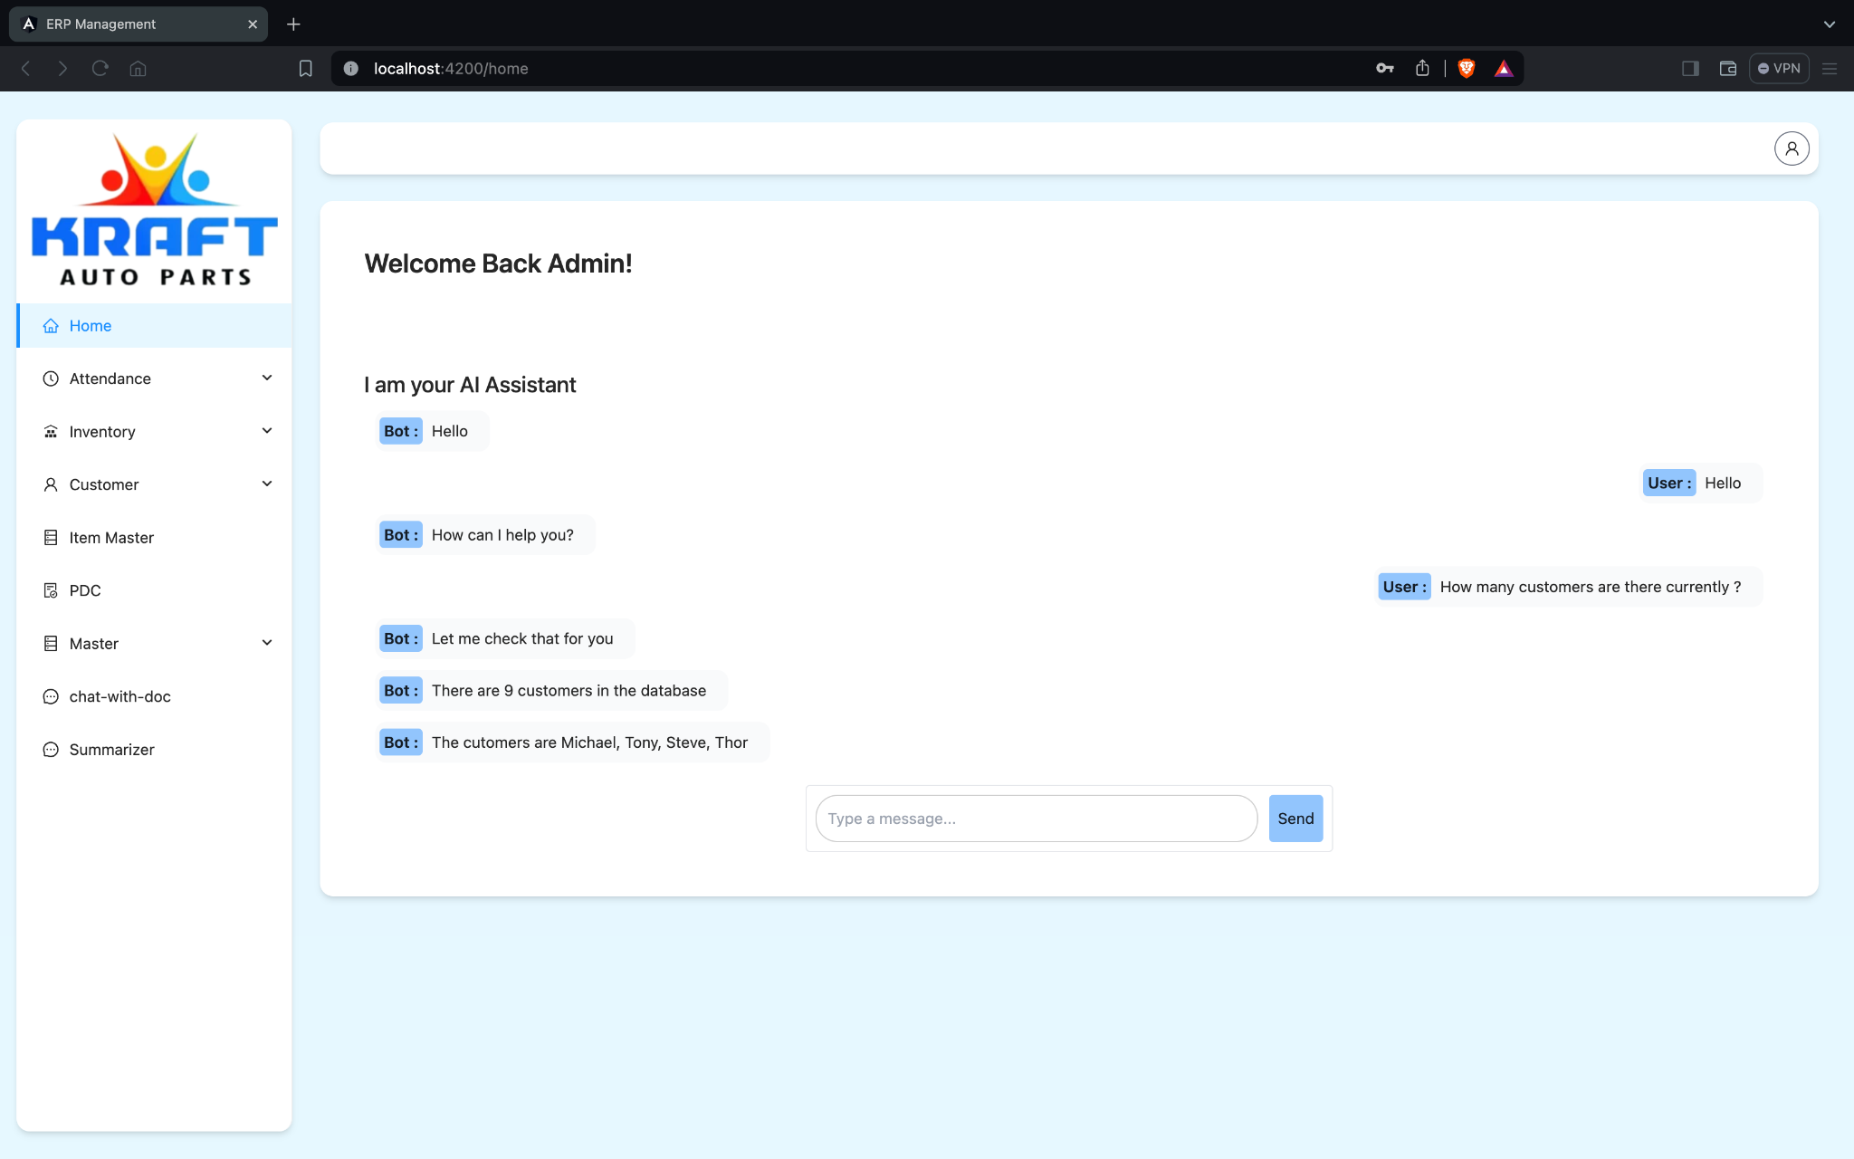
SCREENSHOTS

Slide 19
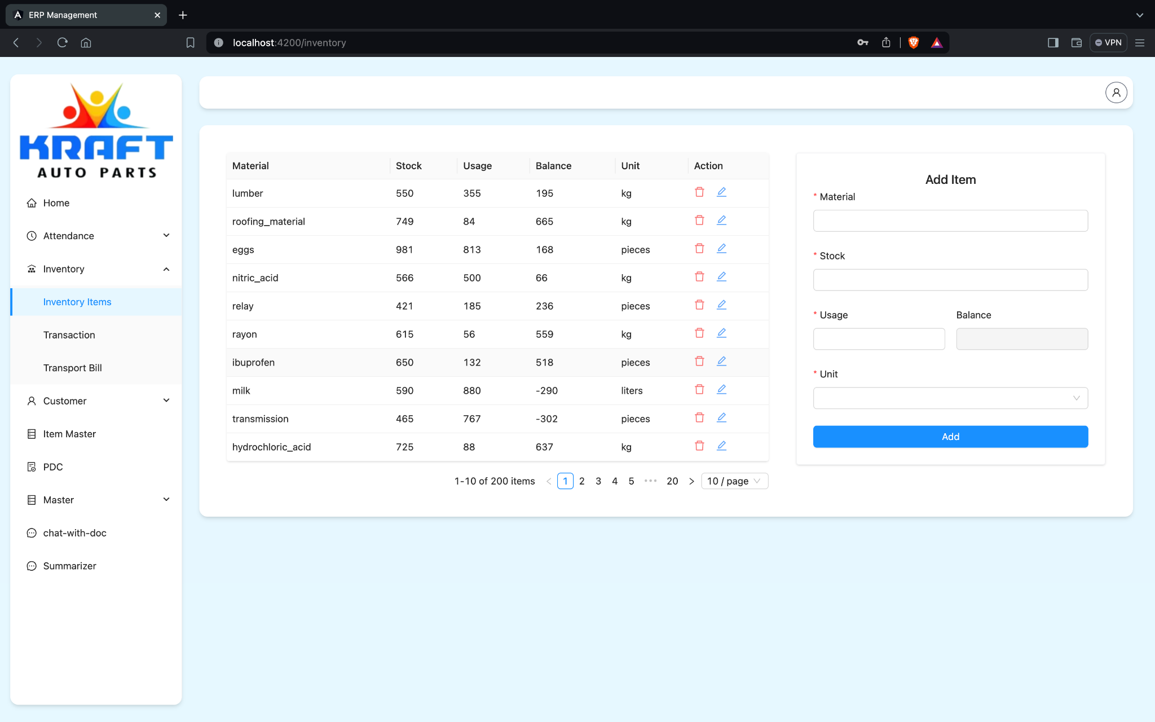

Slide 20
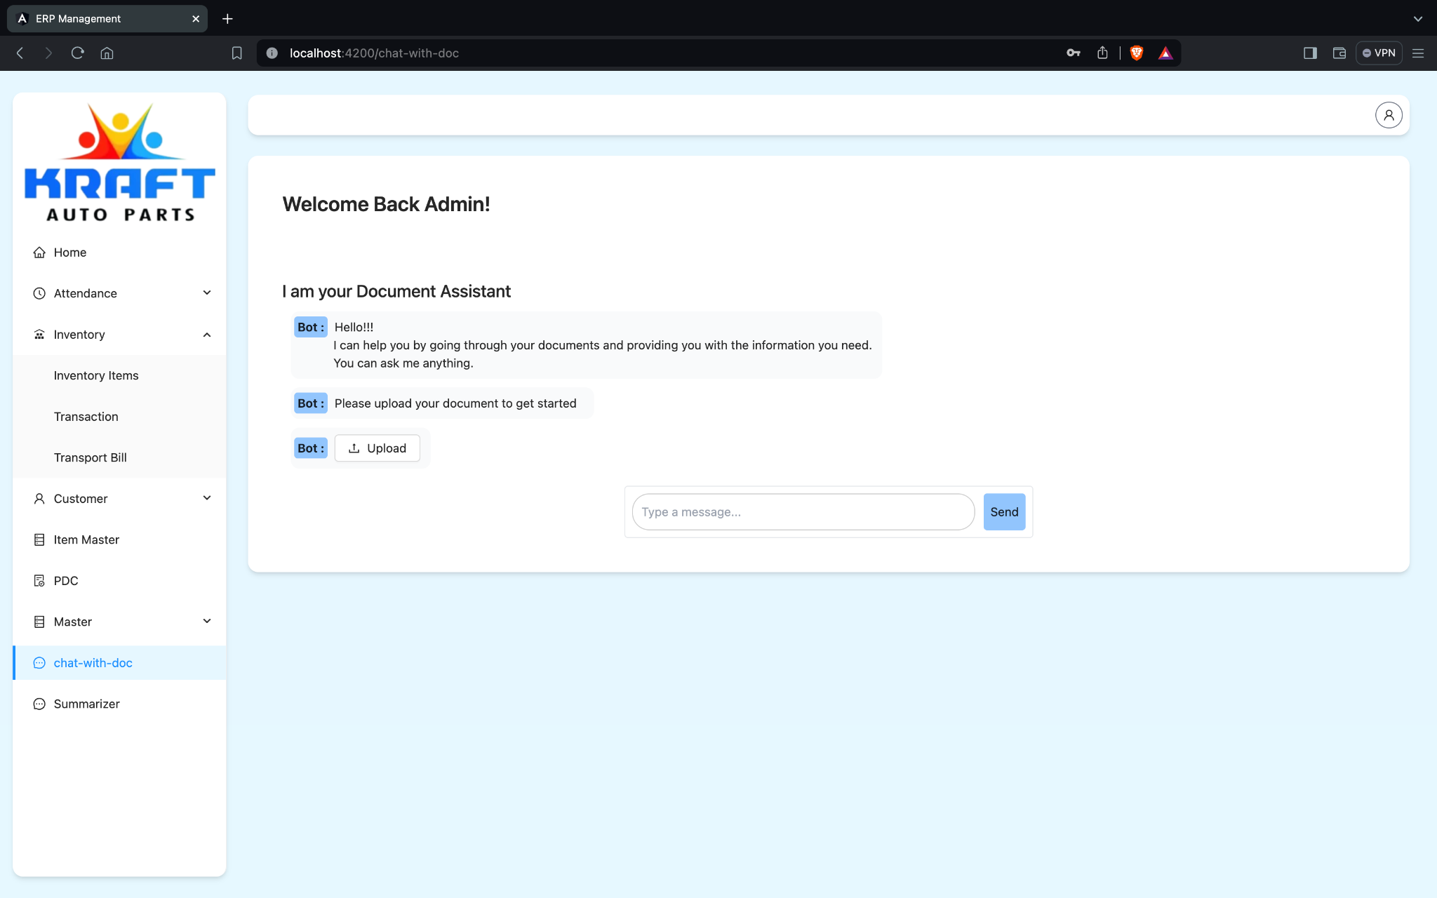

Slide 21
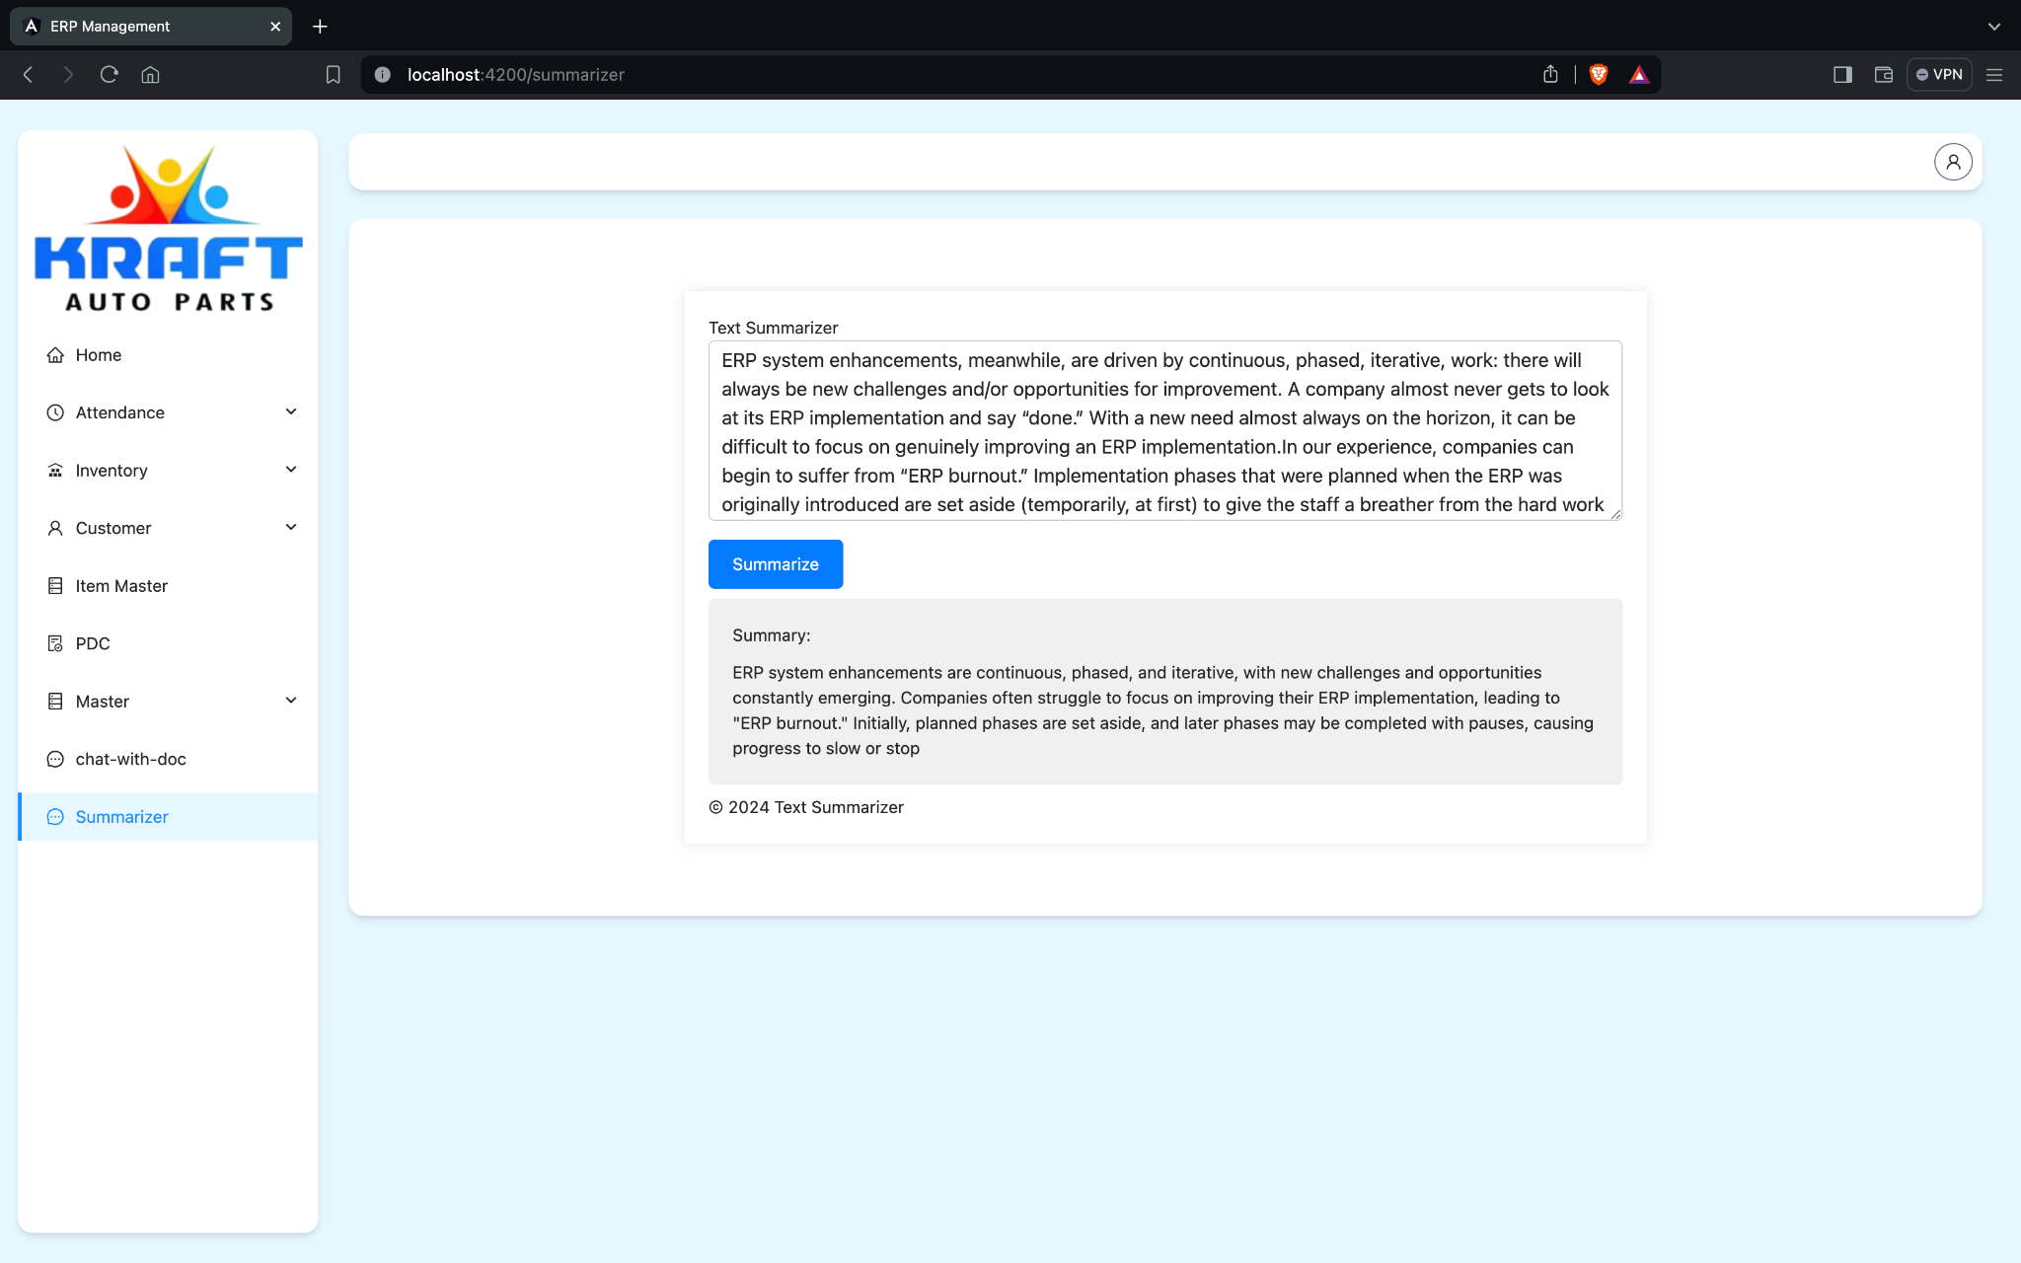

Slide 22
REFERENCES
[1] European Commission, “General data protection regulation,” Recital, vol. 71, pp. 119–114, 2018. [Online]. Available: https://gdpr-info.eu/
[2] European Commission, “Ethics guidelines for trustworthy AI,” 2019. [Online]. Available: https://digital-strategy.ec.europa.eu/en/library/ ethics-guidelines-trustworthy-ai
[3] United Nations, “A framework for ethical AI at the United Nations,” 2021. [Online]. Available: https://unite.un.org/sites/unite.un.org/files/ unite_paper_-_ethical_ai_at_the_un.pdf
[4] A. Jobin, M. Ienca, and E. Vayena, “The global landscape of AI ethics guidelines,” Nat. Mach. Intell., vol. 1, pp. 389–399, 2019.

Slide 23
[5] BAAI, “Beijing AI principles,” 2019. [Online]. Available: https://www. baai.ac.cn/news/beijing-ai-principles-en.html
[6] R. Vought, “Regulation of artificial intelligence applications,” 2020. [Online]. Available: https://www.whitehouse.gov/wp-content/uploads/ 2020/11/M-21-06.pdf
[7] OECD, “Principles on AI,” 2019. [Online]. Available: https://www.oecd. org/going-digital/ai/principles/
[8] UNESCO, “Draft text of the recommendation on the ethics of artificial intelligence,” UNESCO Digit. Library, 2021. [Online]. Available: https: //unesdoc.unesco.org/ark:/48223/pf0000377897
[9] U.K.-Gov, “Data ethics and AI guidance landscape,” 2020. [Online]. Available: https://www.gov.uk/guidance/data-ethics-and-ai-guidancelandscape

Slide 24
[10] P. Cihon, M. J. Kleinaltenkamp, J. Schuett, and S. D. Baum, “AI CERTIFICATION: Advancing ethical practice by reducing information asymmetries,” IEEE Trans. Technol. Soc., to be published, doi: 10.1109/TTS.2021.3077595.
[11] U. S. Government, “Guidance for regulation of artificial intelligence applications,” 2020. [Online] Available: https://www.whitehouse.gov/wpcontent/uploads/2020/01/Draft-OMB-Memo-on-Regulation-of-AI-1- 7-19.pdf
[12] Australia Government, “Australia’s artificial intelligence ethics framework,” 2019. [Online]. Available: https://www.industry.gov.au/data-andpublications/australias-artificial-intelligence-ethics-framework

